Slide 1
Masala House Website
By: Mohammed Brohi
Final Website Presentation for Web 181-DA

Slide 2
Introduction
My final website was an inspiration of an idea I had a while back
It is a community restaurant.
The idea involves a circular blog that involves the neighborhood in events that take place at this restaurant.
Website is mainly geared towards South Asian cuisine. Indian Pakistani, Nepali foods.

Slide 3


Home Page
Main index page has a welcome message with Navigation
Displays moto of the business
Links to connect with Facebook, Google, Twitter and Pintrest.

Slide 4
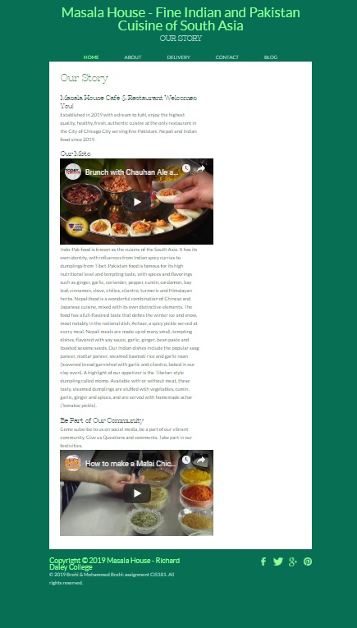
Our Story
Introduction to the story
of the business, YouTube <iframe> links to a couple of videos related to the business.

Slide 5
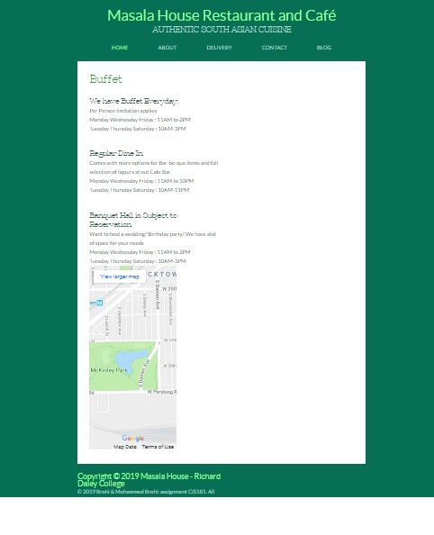
Delivery options
Timings page relevant to
Operation hours of the business.
Active Map from GoogleMaps
Pin is set to the Geographic
Co-ordinates
Of the Restaurant.

Slide 6
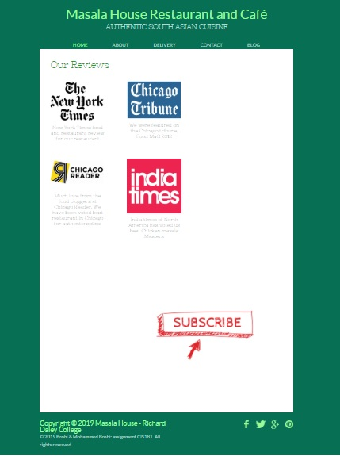
Review Link Page
Multiple links to Different publications that may contain reviews for the business.
NYT link, Chicago Tribune
Chicago Reader, India Times
YouTube Video Subscription

Slide 7
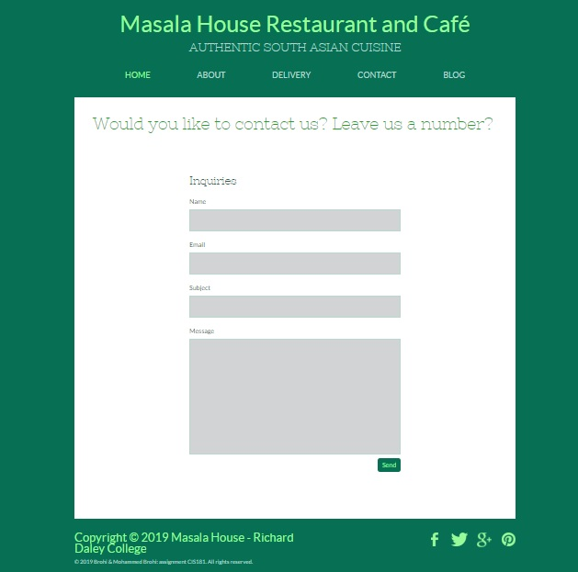
Contact Us form
Form page that is connected to Php link to the site
If visitors would like to leave a comment or suggestion.
*Note all links are continuous on each section of the website

Slide 8
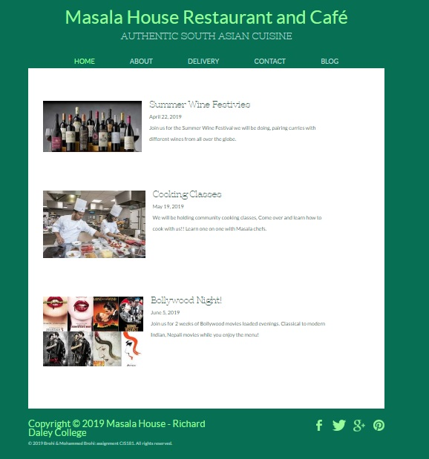
Blog links
Topics that would be linked
To dynamic parts of a blog spot
For the restaurant.
Current topics of the month
Or season.

